Slide 1
Beginning a CLIL program
Successes and Challenges

Slide 2
What is CLIL?
Content and Language Integrated Learning
vs
Communication
Culture
Content
Cognition
Notes:
Content and Language Integrated Learning
Heavy emphasis on communication over accuracy
Communication, Culture, Content, Cognition – equally important
Should draw on other curriculum areas
Concepts should be new to provide a need to learn the language

Slide 3
Why we chose CLIL at Glengarry Primary
integrated content
thinking skills
addresses lack of diversity
motivated students
some language knowledge
Notes:
Fits our school philosophy with an emphasis on thinking and integrating content
Had been minimal language program
Already working on mindsets and thinking skills
Very supportive principal (ex language teacher)
Motivated kids – looking for challenges
The conditions are right for this style of learning framework – only obstacle is some parents opinions but they are a vocal minority
To address lack of cultural diversity in school and town
We were looking for a challenge professionally
CLIL fits with our specialist roles anyway – adds an element
Despite our rusty language skills, we can make it work

Slide 4
How it looks
Kitchen Garden
Art
CLIL
Focus on communication and meaning making
3 hours a week
Kitchen Garden/Art
CLIL
Notes:
We focus on communication and meaning making
Integrated with art and kitchen garden – needs the art to broaden the content
3 hours per week per grade – 2 hour and 1 hour sessions, team teaching with pairs of grades
One session is mainly CLIL but pops up in other sessions
Start in Indonesian for instruction, group work – teacher tries to stick with language, then wrap up often in English

Slide 5
How it looks
CLIL
Intro
Instructions are given mainly in the target language
Group
Students are not compelled to speak in the target language, but often do
Reflect
Reflection is usually spoken in English, this is a good time to address any misconceptions or difficult concepts.
Notes:
Start in Indonesian for instruction, group work – teacher tries to stick with language, then wrap up often in English
Students not compelled to speak Indonesian but usually do.
Wrap up is a good time to address misconceptions and difficult concepts about the language.
Usually a cultural component and some familiar thinking routines.
This is similar to English reading or writing

Slide 6
How we started
2016
leading languages course
CLIL course
2018
CLIL
all grades
2017 CLIL trial
Notes:
Bastow Leading Languages course in 2016, then CLIL later that year. Trialled a unit of work.
2017 started small by planning some lessons and both teaching some CLIL
2018 growing the program with CLIL in every unit of work.
Have shared planning time

Slide 7
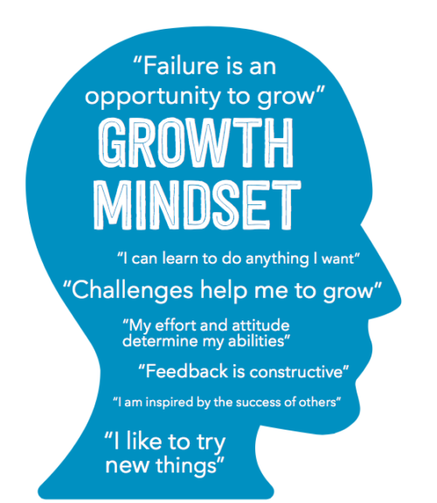
How we started
Shared planning time & co-teaching
Supportive Principal!
Students are used to being challenged. Modelled idea that we were ALL learning, even the teachers.
Notes:
Have shared planning time
Very supportive principal putting support in place
Some kids had some language experience prior to CLIL – new some counting, greetings, colours, etc.
Talked a lot to students and modelled the idea that there would be new learning for all of us – this is normal in our school.
Students were used to being challenged and are fairly used to learning about learning.

Slide 8
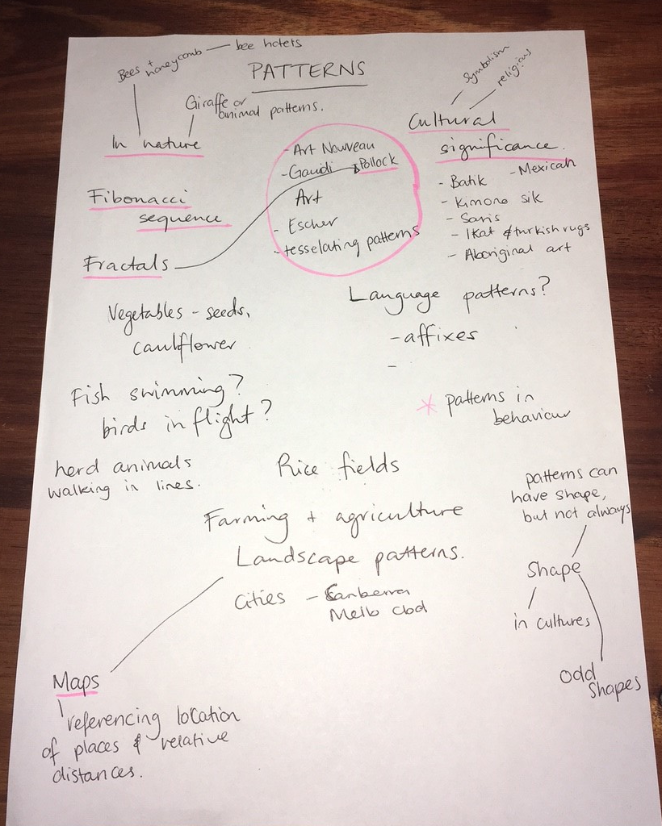
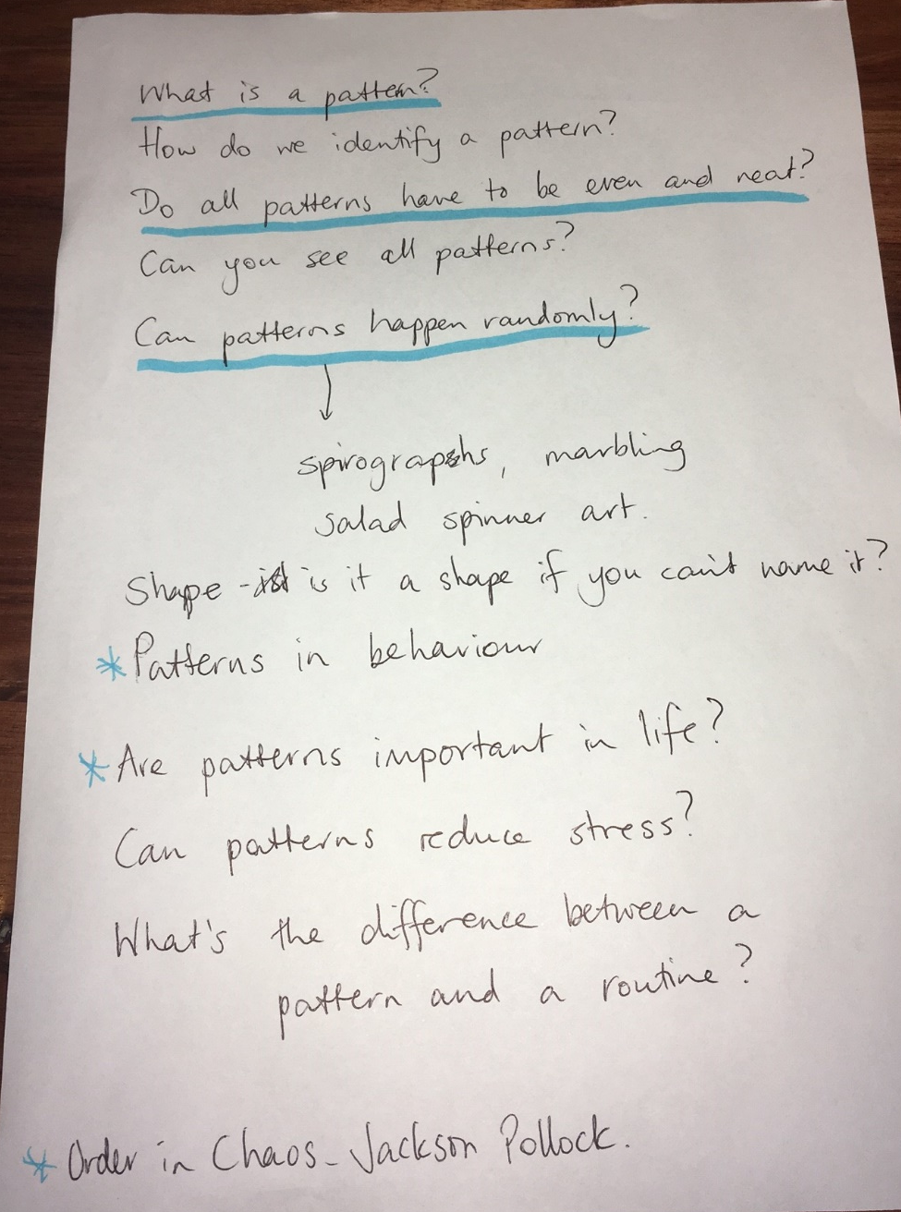
How we plan
Notes:
Discuss beforehand what might be some good topics/concepts
Input from students
Guiding questions/concepts
Reference the curriculum

Slide 9
How we plan
Notes:
Brainstorm learning experiences
Narrow the focus
Go back to the curriculum and look for more opportunities
Reign in our ideas and check that we are covering the four Cs of CLIL
Most of the time – not every lesson always.
The cognition part is happening even if its not formalised.

Slide 10
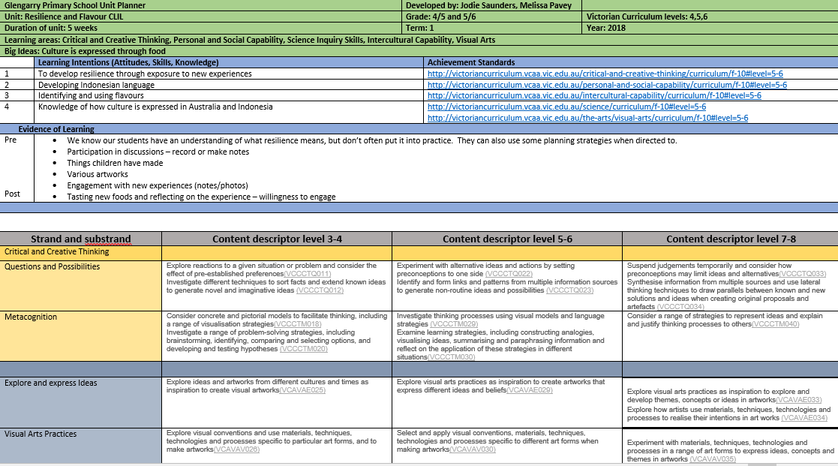
How we plan
Notes:
Unit outline and start filling in our proforma
Weekly planning – look ahead and amend as we go – Unit plan is a working document – John Hattie’s – Where am I going? How am I doing? Where to next?

Slide 11
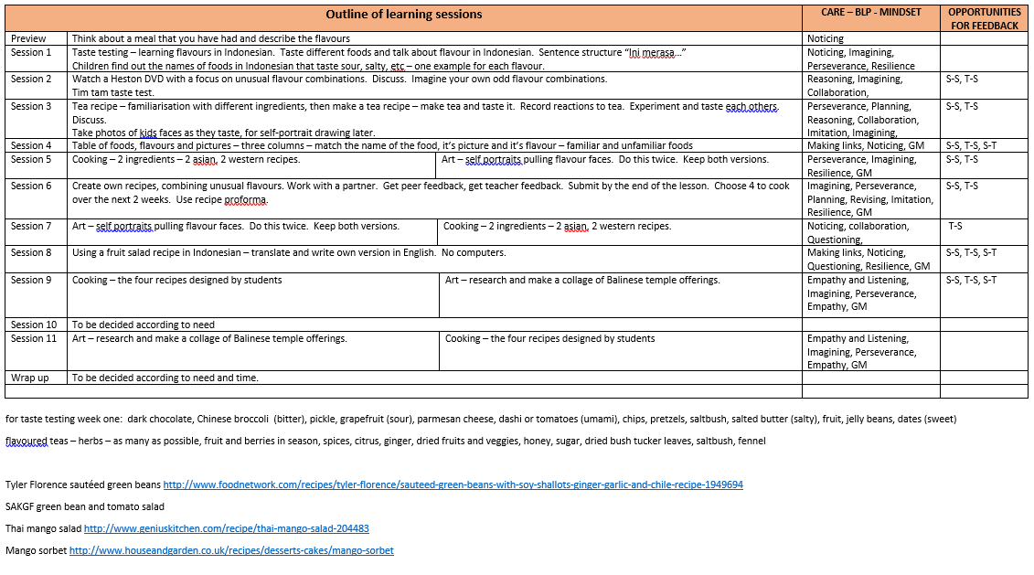
How we plan
Notes:
Unit outline and start filling in our proforma
Weekly planning – look ahead and amend as we go – Unit plan is a working document – John Hattie’s – Where am I going? How am I doing? Where to next?
Visible learning in action
Feedback S/T and T/S all the time

Slide 12
What’s working?
Notes:
Ready, Fire, Aim (Nottingham)

Slide 13
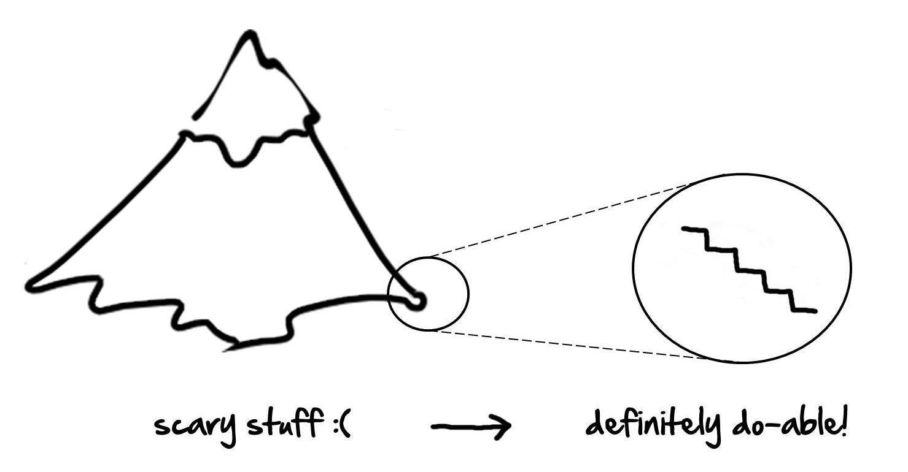
What’s working?
Notes:
Starting small
Visited Westagarth PS yesterday – need to continually learn and reflect on our practice

Slide 14
What’s working?
CLIL framework
variety
Notes:
Team teaching
Planning together works well
Less arduous work – planning takes less time
Kids are enjoying it – high levels of engagement
The variety across the week- also a challenge
Passion for CLIL – rewarding and stimulating for us and the kids
Having a framework – unit planner and CLIL framework Referencing the curriculum continually
Kids are driving it more and content keeps moving – Sometimes make a point of telling kids which ideas they contributed
Worrying less about language accuracy and more about meaning
Reading results are outstanding – can’t prove link, but know it’s there because they have to use good literacy strategies (which we will show in a minute)

Slide 15
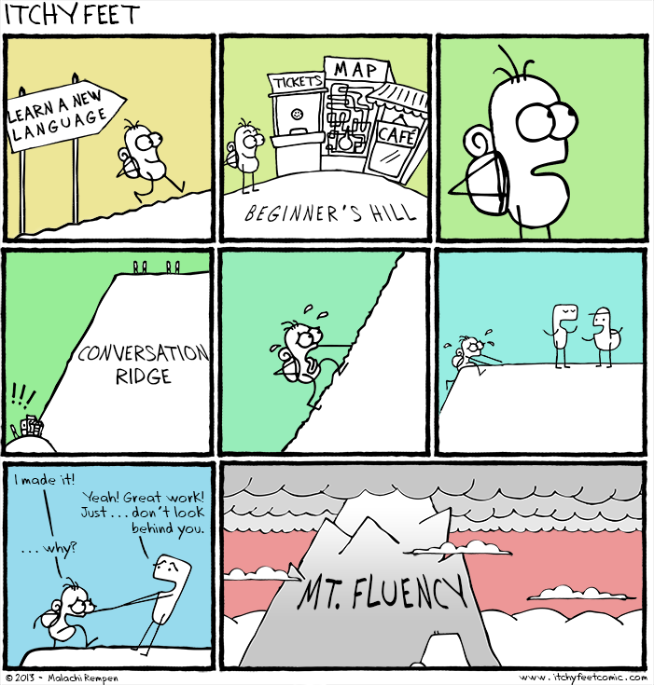
What’s challenging?
Creating/finding resources
Constantly finding new/exciting concepts
Notes:
Updating our language skills – partly distance
Creating resources is time consuming
Constantly finding unknown concepts within language limitation
Over thinking what makes a valuable concept – we have overdone it recently
Sometimes reigning in ideas is hard

Slide 16
What’s challenging?
Lack of understanding
Finding a CRT
Notes:
Lack of understanding from other staff
Finding CRTs or succession planning – skills and attitude to learning
Long-term viability of the program

Slide 17
Have a go
Notes:
Indo recipe- have a go at translating in groups
Point out that to be successful you need to apply reading strategies
Students were given the recipe & discussed that this task would be challenging.
Have a go then share strategies used /Point out meaning-making strategies if needed

Slide 18
Resource examples
Notes:
Books and other ideas – ask to share

